Slide 1
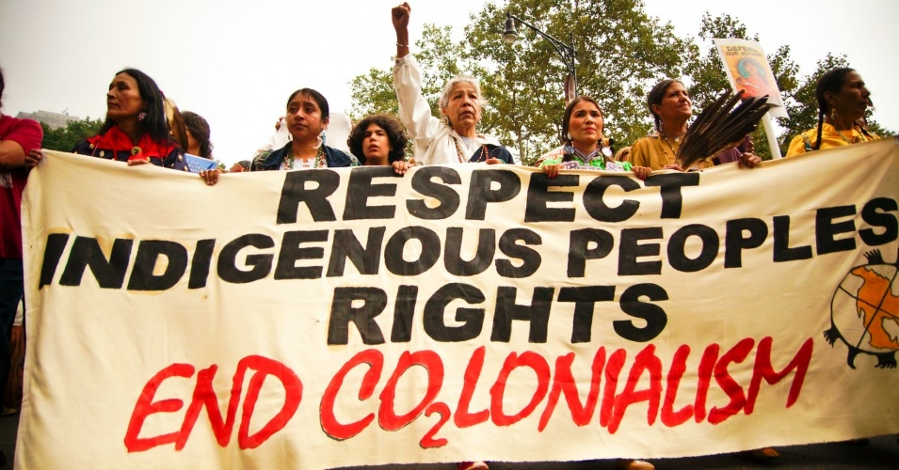
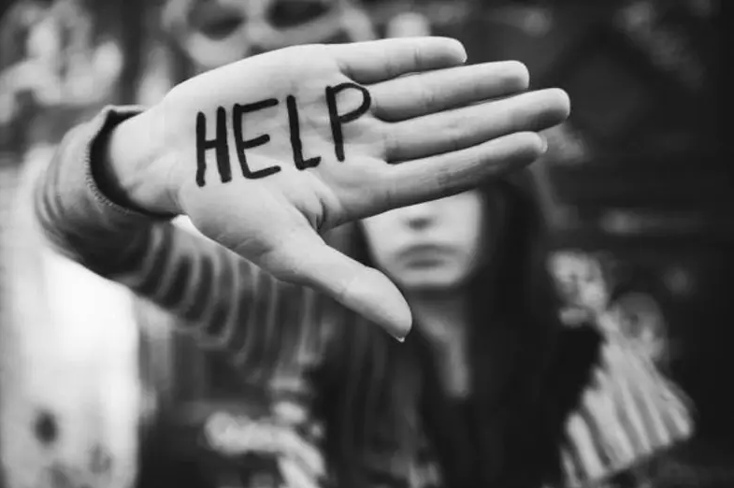
Exploring the Trafficking of Indigenous Women and Girls: What are the Underlying Factors?
Jaiden Veal, Department of Psychology, University of New England, Biddeford ME 04005
Introduction
Defining Human Trafficking
Understanding the Situation
“Trafficking has existed in Native communities for centuries, since the earliest point of contact with Europeans” (Sweet, 2015). Human trafficking affects some of the most vulnerable populations around the world. The trafficking of persons is often associated with socio-economic problems, conflicts, and or natural disaster. Women, especially, are at a disadvantage due to symbolic violence and structural poverty. While there is little data to support human trafficking within Indigenous communities here in the United States and Canada, the deeply rooted challenges Indigenous people have endured for centuries such as colonization, forced migration, prostitution, and generational trauma are but a few of the underlying concerns.
Despite the government's significant efforts to combat trafficking since the passage of the Trafficking Victim Protection Act (TVPA) in 2000 here in the United States and Canada’s added segment to the Immigration and Refugee Protection Act in 2002 that addressed trafficking briefly, sex trafficking of Indigenous women and girls continues strong.
The TVPA enacted in 2000 defines what the U.S. constitutes as labor and sex trafficking:
Labor trafficking is “the recruitment, harboring, transportation, provision, or obtaining of a person for labor or services, through the use of force, fraud, or coercion for the purposes of subjection to involuntary servitude, peonage, debt bondage, or slavery.”
Sex trafficking is: “the recruitment, harboring, transportation, provision, obtaining, patronizing, or soliciting of a person for the purposes of a commercial sex act, in which the commercial sex act is induced by force, fraud, or coercion, or in which the person induced to perform such an act has not attained 18 years of age.”
Canada’s added segment to the Immigration and Refugee Protection Act in 2002 displayed when they define as human trafficking ” [n]o person shall knowingly organize the coming into Canada of one or more persons by means of abduction, fraud, deception or use of threat of force of coercion” (Bourgeois, 2015).
Indigenous women and girls are classified as one of the most vulnerable populations to be trafficked both in the United States and Canada.
Many of the underlying issues associated with the trafficking of the Indigenous link back to colonization, forced migration to secure land, and governmental motives to eliminate Native populations.
Risk factors include poverty, prostitution, violence (physical and sexual), and generational trauma.
The educational gap associated with human trafficking has limited the number of indigenous women and girls being identified, has limited their transition out of trafficking, as well as restoration of wellness
Although limited, current literature has focused on the commercial sex industry, indicating its prevalence over other forms of human trafficking.
Federal, state, and tribal governments must work diligently to ensure Indigenous women are provided with culturally appropriate responses and receive the necessary protections.
Tribal communities must also take initiative to raise public awareness and devote time to creating culturally specific legal and victim services
Necessary steps to aid survivors and prevent future trafficking are:
- Survivor identification
- Aiding survivors in exiting trafficking
- Restoration of Psychological Wellness
Noteworthy Statistics to Consider
According to the National Institute of Justice in 2006 an estimated 34.1% of Native American women had been victims of sexual assault, whereas 17.9% of Caucasian women had been victims of sexual assault (Hart, 2010)
Health professionals also have a significant role which is suggested by research that indicated 28% of trafficked victims with visit a health care professional while being trafficked (Hodge, 2014).
A study done in 2000 in Canada, found that an estimated 70% of Indigenous prostitutes are working in some of the most dangerous conditions (Deer,2010).
Indigenous women only make up 4.3% of the population in Canada, while 11.3% of Indigenous females make up the total missing cases in Canada (Koepplinger, 2008).
The Minneapolis and St. Paul metropolitan area that houses the second largest urban indigenous community in the country represents one of the fifteen worst metropolitan areas for sex trafficking (Koepplinger, 2008).
Evidence suggests that Indigenous communities experience some of the highest rates of violence in the country
According to Koepplinger, one study found that 80% of Indigenous participants has experienced some form of violence within their family
75% of Indigenous females experienced some form of sexual abuse before the age of 18, 50% before the age of 13, and 25% before the age of 7
Methodology
UNE and UW Library Databases were used, and exploration included:
a. Human Trafficking and Indigenous Populations
b. Relation between colonization and human trafficking of Indigenous women
c. Risk factors contributing to the trafficking of Indigenous Women & girls
d. Preventative measures to end trafficking in Indigenous communities
Work Cited
Major Findings
The Federal Violence Against Women Act of 1994 (VAWA)
Aguirre, R. (2017). Sex Trafficking and Rural Communities: A Review of the Literature, Contemporary Rural Social Work Journal: Vol. 9 : No. 1 , Article 13
Bourgeois, R. (2015). Colonial exploitation: The Canadian State and the Trafficking of Indigenous Women and Girls in Canada. UCLA Law Review, 62(6), 1426-1463.
Chong, N. (2014). Human Trafficking and Sex Industry: Does Ethnicity and Race Matter?, Journal of Intercultural Studies, 35 (2), 196-213, DOI: 10.1080/07256868.2014.885413
Cockbain, E., Bowers, K. Human trafficking for sex, labour and domestic servitude: how do key trafficking types compare and what are their predictors?. Crime Law Soc Change 72, 9–34 (2019). https://doi.org/10.1007/s10611-019-09836-7
Congressional Research Services. (2013). Public Law No: 113-4. Retrieved from: https://congress.gov/bill/113th-congress/senate-bill/47.
Deer, S. (2010). Relocation revisited: Sex trafficking of native women in the united states. William Mitchell Law Review, 36(2), 621-683.
Department of Justice. (2017). Framing Paper Summary: Consultation Questions on Conducting Research and Training on Human trafficking. Retrieved from: https://www.justice.gov/ovw/page/file/998081/download
Ford, K (n.d.). Tribal Justice and Sex Trafficking: Implications for State Court Response. Retrieved from: https://courtinnovation.org
Hart, R. A. (2010). No exceptions made: Sexual assault against Native American women and the denial of reproductive healthcare services. Wisconsin Journal of Law, Gender & Society, 25(2), 209-260.
Melton, A (n.d). Public Law 280: Issues and Concern for Victims of Crime in Indian Country. Retrieved from: http://www.aidainc.net/Publications/pl280.htm
Hodge, D. (2014). Assisting Victims of Human Trafficking: Strategies to Facilitate Identification, Exit from Trafficking, and the Restoration of Wellness. Social Work, 59(2), 111-118.
Koepplinger, S. (2008). Sex trafficking of American Indian women and girls in Minnesota. University of St. Thomas Law Journal, 6(1), 129-137.
Johnson, A. L. (2012). perfect storm: The U.S. anti-trafficking regime's failure to stop the sex trafficking of American Indian women and girls. Columbia Human Rights Law Review, 43(2), 617-710.
Joshi, A. (2002). The face of human trafficking. Hastings Women's Law Journal, 13(1), 31-52.
Modi, M. N., Palmer, S., & Armstrong, A. (2014). The role of Violence Against Women Act in addressing intimate partner violence: a public health issue. Journal of women's health (2002), 23(3), 253–259. https://doi.org/10.1089/jwh.2013.4387
Okech, D.; Morreau, W.; Benson, K. (2012). Human trafficking: Improving victim identification and service provision. International Social Work, 55(4), 488-503.
Tribal Court Clearinghouse. (n.d). Introduction to the Violence Against Women Act. Retrieved from: https://www.tribal-institute.org/lists/title_ix.htm
Colonization, motives to secure land (forced migration), and residential schools (eliminating Native populations) play a major role in the hardships Indigenous communities have faced and still do today.
Current anti-trafficking legislation has failed Indigenous trafficking survivors, due to the focus being on foreign victims, which has ignored domestic victims.
To date, there are no Indian tribes within the United Stated that have statutes criminalizing human trafficking and there are a limited number of tribes that criminalize prostitution.
- Of the tribes that do criminalize prostitution, the act of both the prostitute and patron is criminalized.
Risk factors for Indigenous women and girls include:
Poverty
Prostitution
Violence
Generational trauma
VAWA is a combination of programs, initiatives, and various actions that were designed to improve criminal justice and community-based responses to violence against women, which included sexual violence in the United States.
Due to Public Law 280 that was passed in 1953, certain jurisdictions were transferred from the federal government to the state of Indian country.
VAWA has been reauthorized three times since 1994 and it was not until 2013 when it included Title IX Safety for Indian Women.

Slide 2
References
Aguirre, R. (2017). Sex Trafficking and Rural Communities: A Review of the Literature, Contemporary Rural Social Work Journal: Vol. 9 : No. 1 , Article 13
Bourgeois, R. (2015). Colonial exploitation: The Canadian State and the Trafficking of Indigenous Women and Girls in Canada. UCLA Law Review, 62(6), 1426-1463.
Chong, N. (2014). Human Trafficking and Sex Industry: Does Ethnicity and Race Matter?, Journal of Intercultural Studies, 35 (2), 196-213, DOI: 10.1080/07256868.2014.885413
Cockbain, E., Bowers, K. Human trafficking for sex, labour and domestic servitude: how do key trafficking types compare and what are their predictors?. Crime Law Soc Change 72, 9–34 (2019). https://doi.org/10.1007/s10611-019-09836-7
Congressional Research Services. (2013). Public Law No: 113-4. Retrieved from: https://congress.gov/bill/113th-congress/senate-bill/47.
Deer, S. (2010). Relocation revisited: Sex trafficking of native women in the united states. William Mitchell Law Review, 36(2), 621-683.
Department of Justice. (2017). Framing Paper Summary: Consultation Questions on Conducting Research and Training on Human trafficking. Retrieved from: https://www.justice.gov/ovw/page/file/998081/download
Ford, K (n.d.). Tribal Justice and Sex Trafficking: Implications for State Court Response. Retrieved from: https://courtinnovation.org
Hart, R. A. (2010). No exceptions made: Sexual assault against Native American women and the denial of reproductive healthcare services. Wisconsin Journal of Law, Gender & Society, 25(2), 209-260.
Melton, A (n.d). Pubic Law 280: Issues and Concern for Victims of Crime in Indian Country. Retrieved from: http://www.aidainc.net/Publications/pl280.htm
Hodge, D. (2014). Assisting Victims of Human Trafficking: Strategies to Facilitate Identification, Exit from Trafficking, and the Restoration of Wellness. Social Work, 59(2), 111-118.
Koepplinger, S. (2008). Sex trafficking of American Indian women and girls in Minnesota. University of St. Thomas Law Journal, 6(1), 129-137.
Johnson, A. L. (2012). perfect storm: The U.S. anti-trafficking regime's failure to stop the sex trafficking of American Indian women and girls. Columbia Human Rights Law Review, 43(2), 617-710.
Joshi, A. (2002). The face of human trafficking. Hastings Women's Law Journal, 13(1), 31-52.
Modi, M. N., Palmer, S., & Armstrong, A. (2014). The role of Violence Against Women Act in addressing intimate partner violence: a public health issue. Journal of women's health (2002), 23(3), 253–259. https://doi.org/10.1089/jwh.2013.4387
Okech, D.; Morreau, W.; Benson, K. (2012). Human trafficking: Improving victim identification and service provision. International Social Work, 55(4), 488-503.
Tribal Court Clearinghouse. (n.d). Introduction to the Violence Against Women Act. Retrieved from: https://www.tribal-institute.org/lists/title_ix.htm

